Slide 1

IELTS Oggy
IELTS Academic Study Material
Part 1

Slide 2
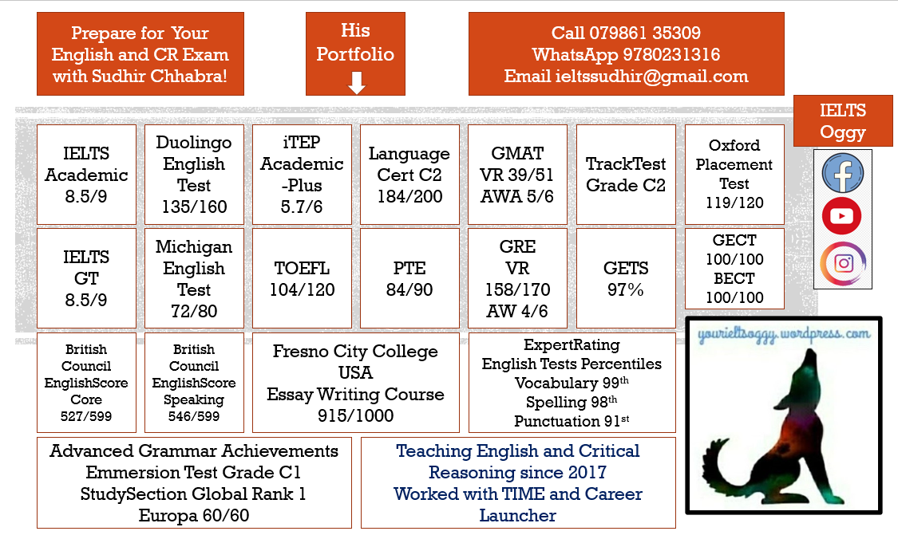
Maker and Teacher

Slide 3
Day 1
Reading T F NG Writing Task 2 Introduction Speaking Introduction

Slide 4
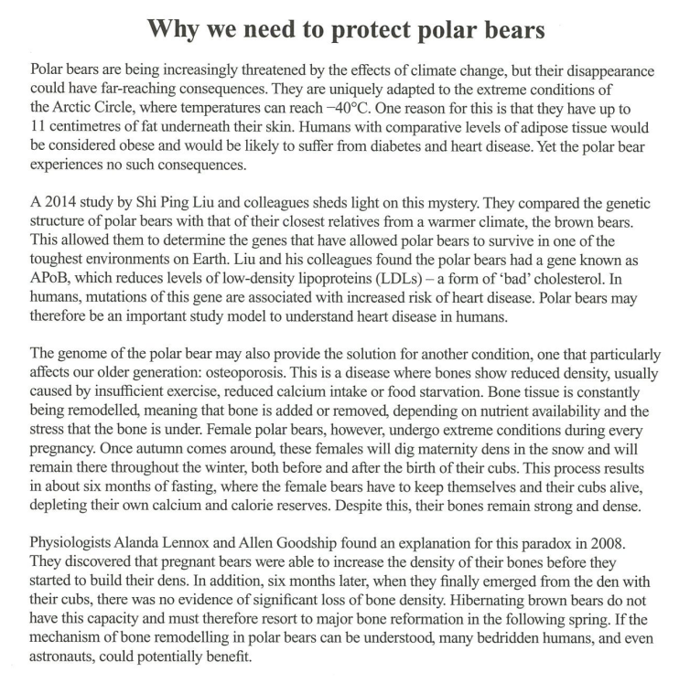

Slide 5
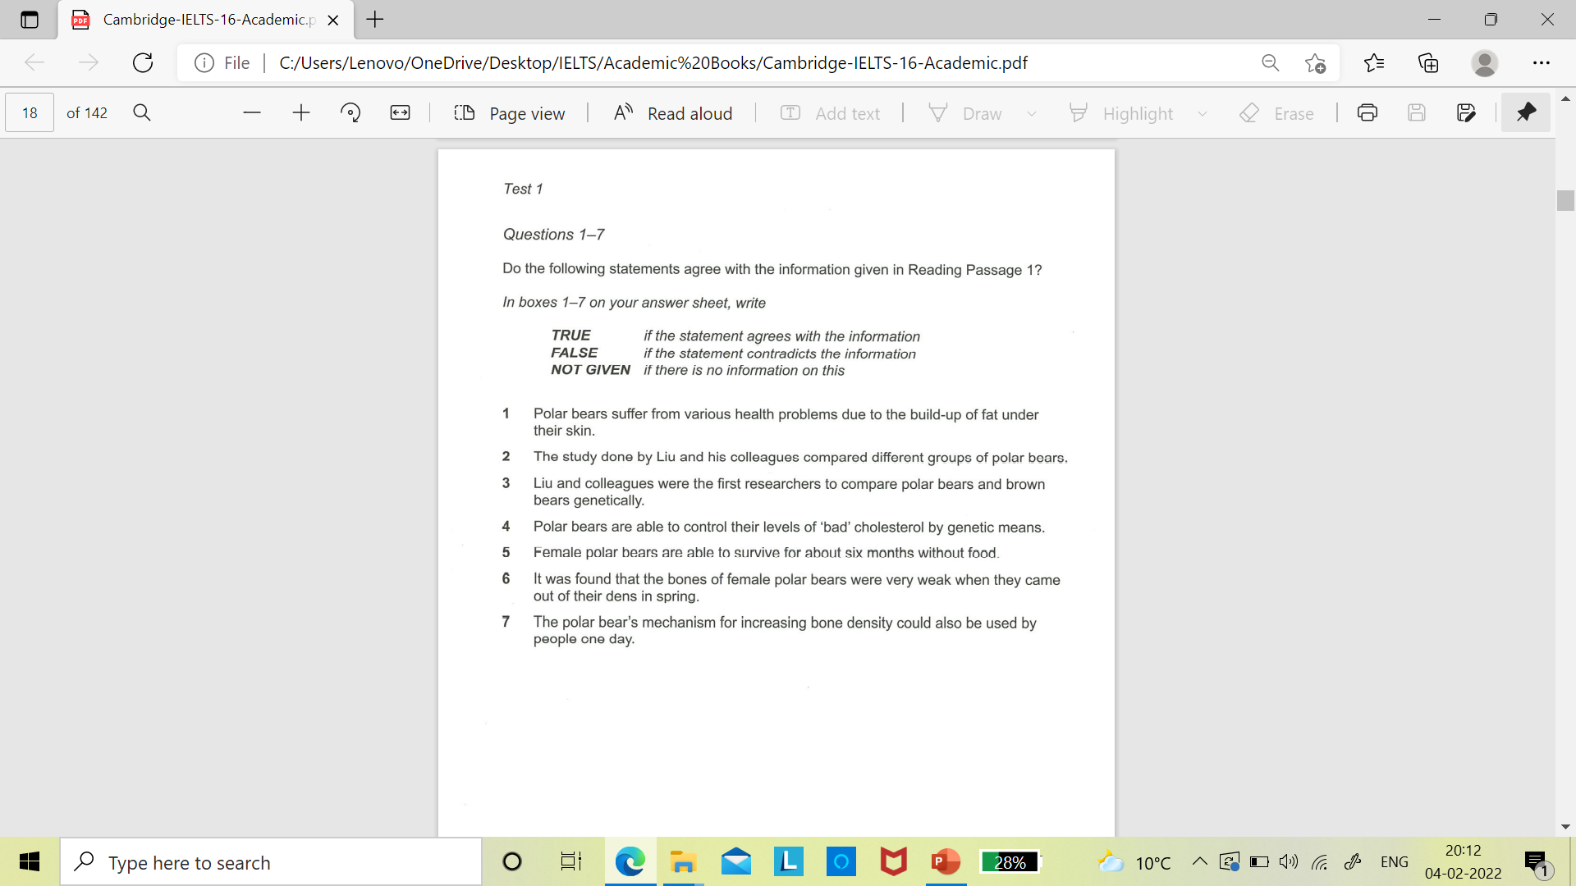

Slide 6
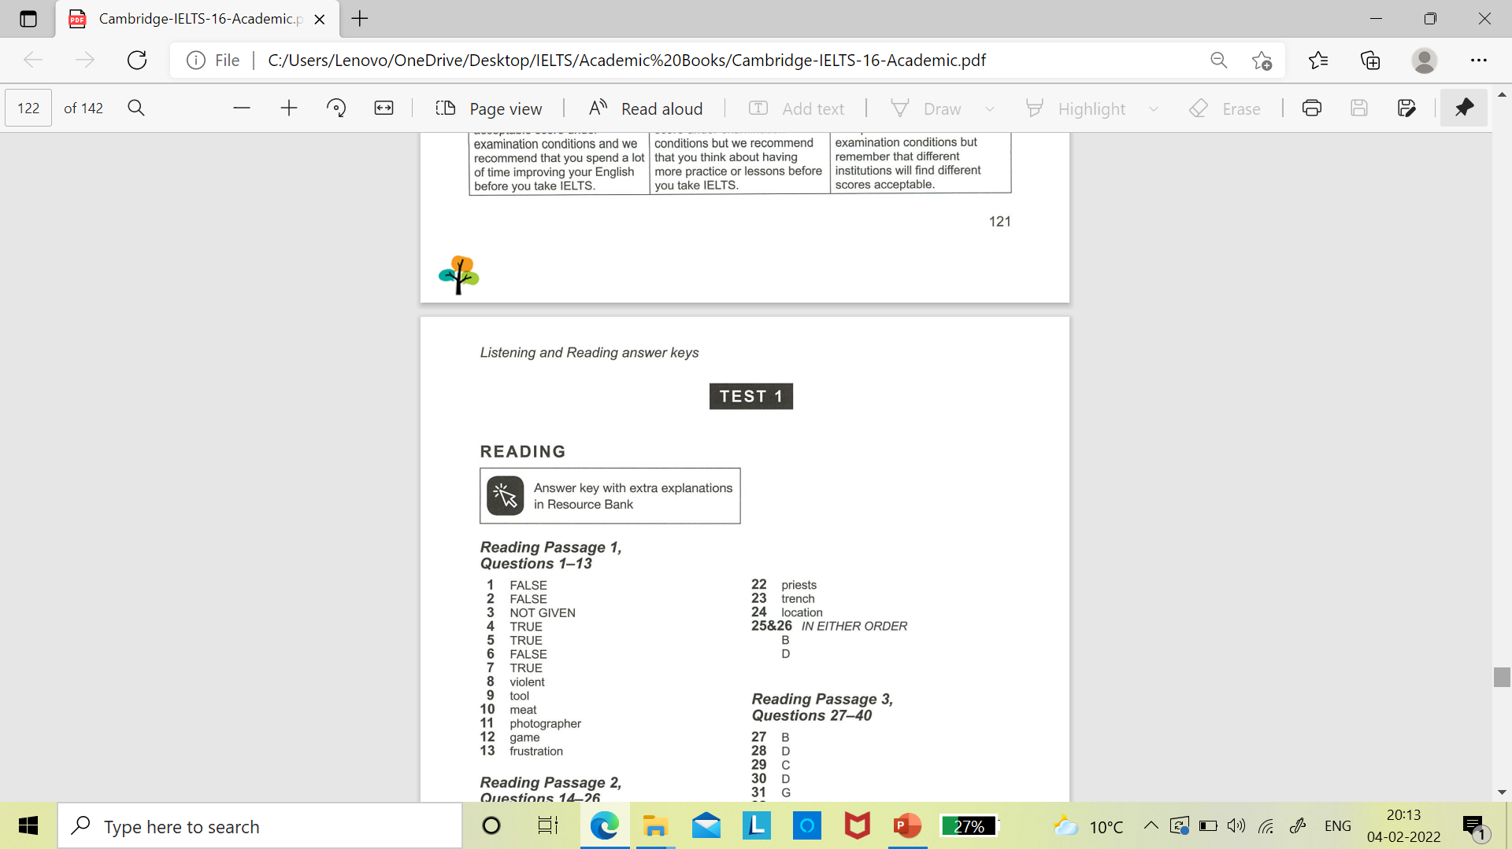

Slide 7
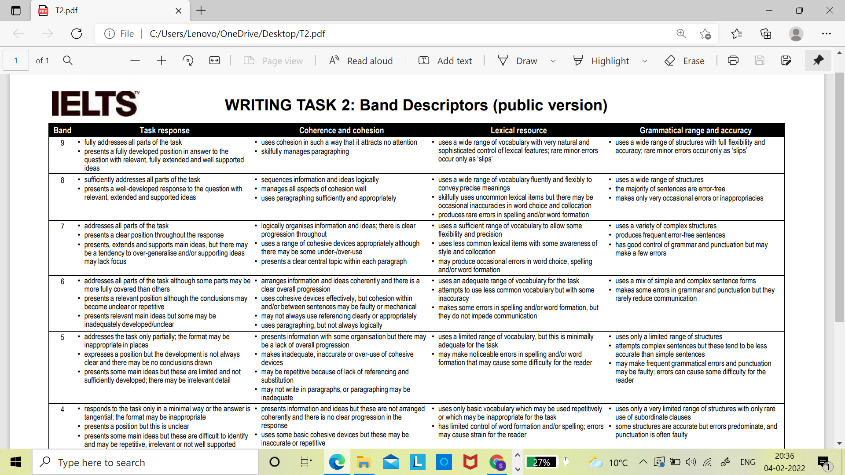

Slide 8
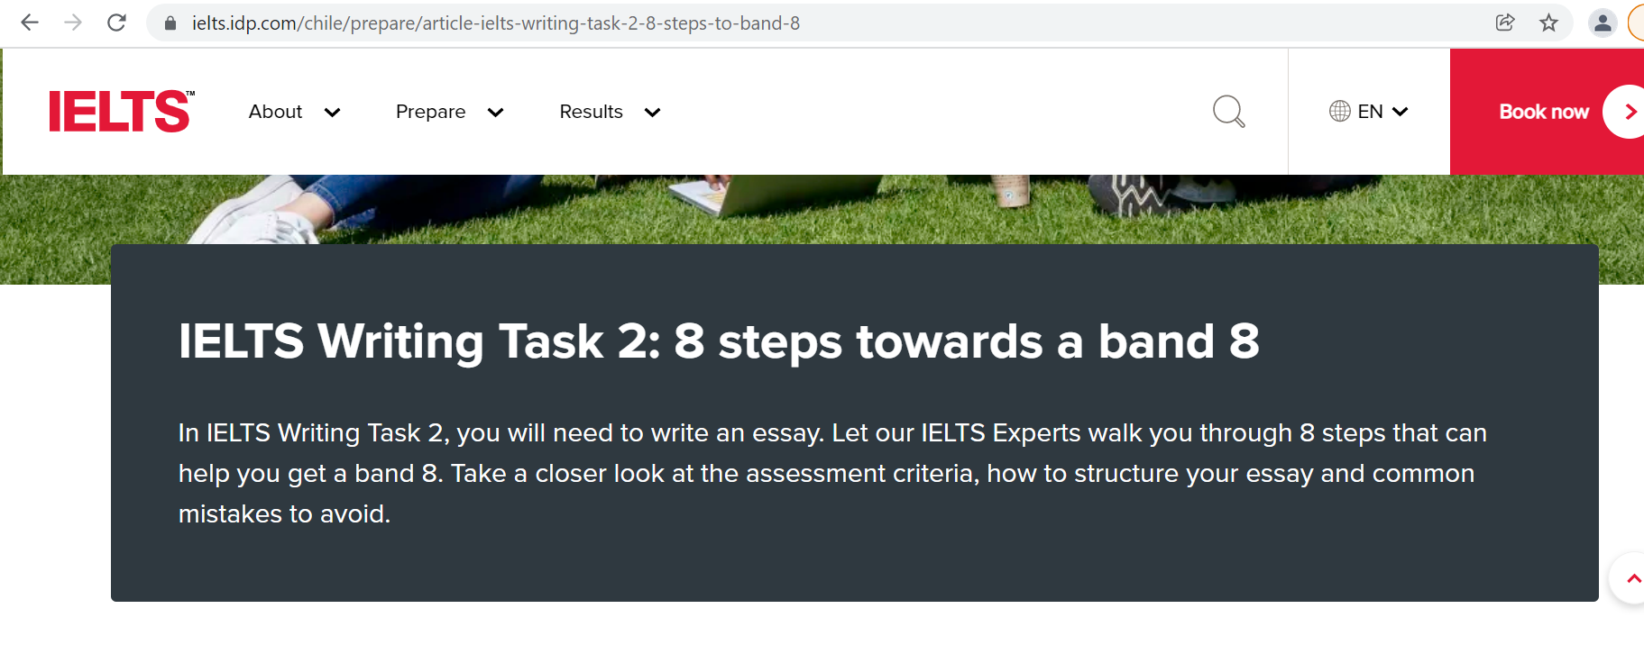
https://ielts.idp.com/chile/prepare/article-ielts-writing-task-2-8-steps-to-band-8

Slide 9
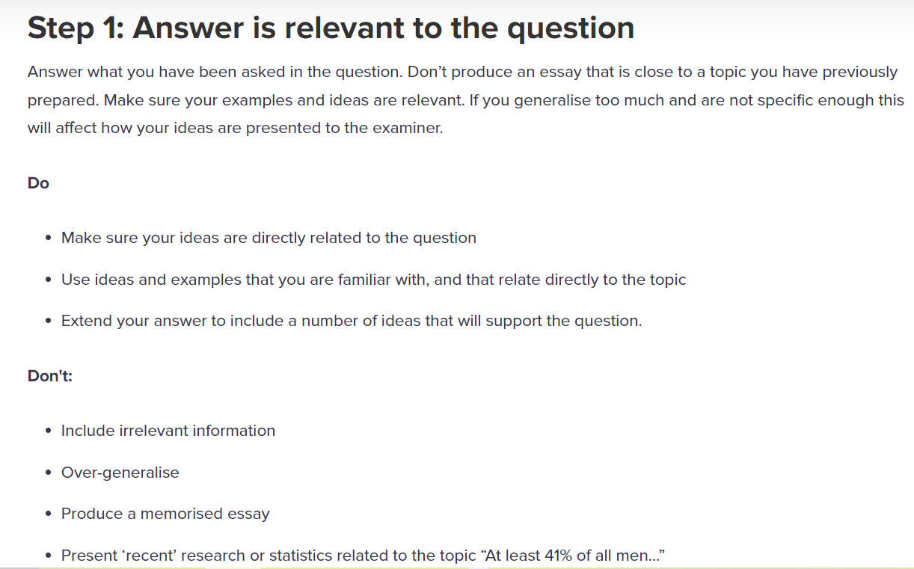

https://www.instagram.com/p/CGzh3LqJHJG/

Slide 10
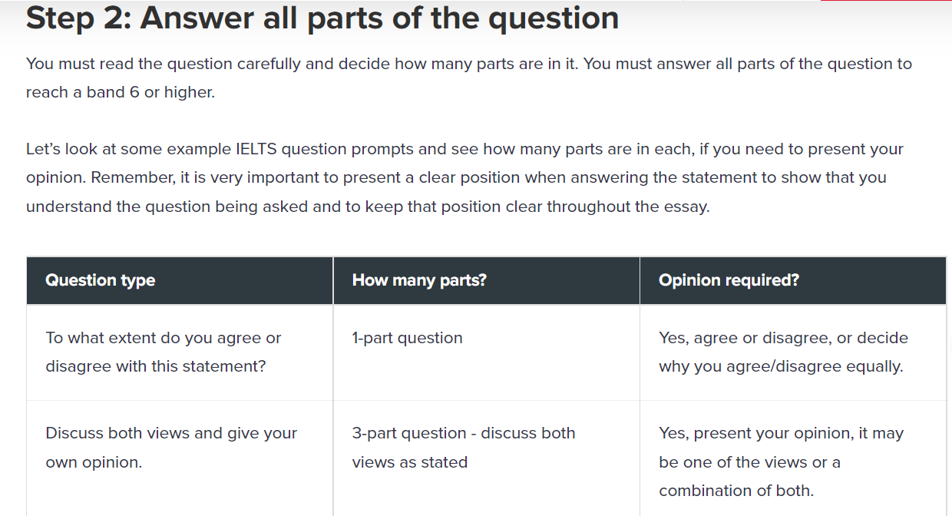

Slide 11
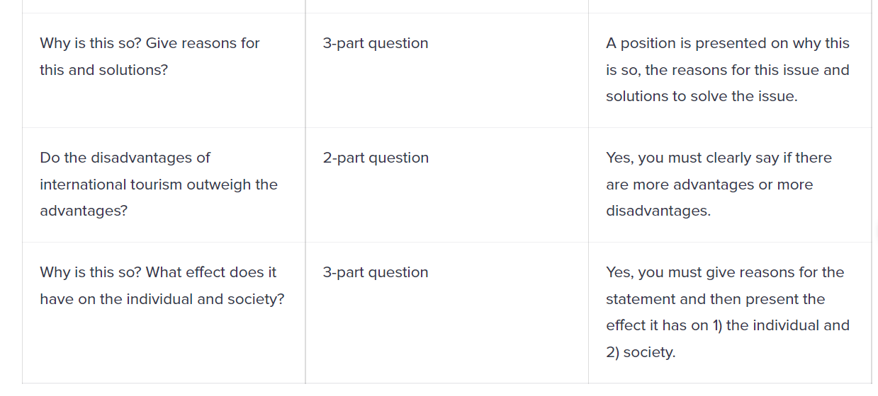

Slide 12
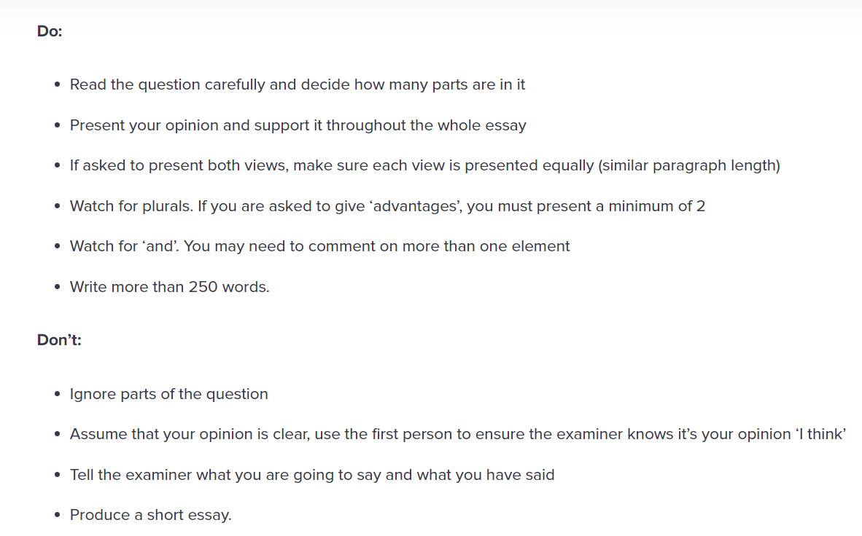

Slide 14
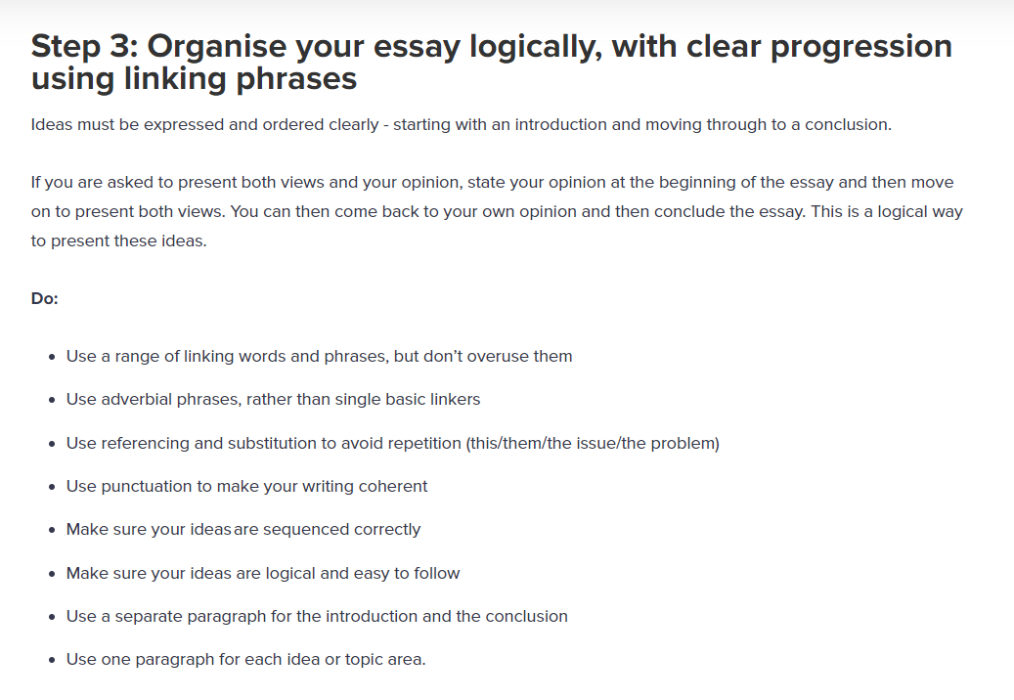

Slide 15
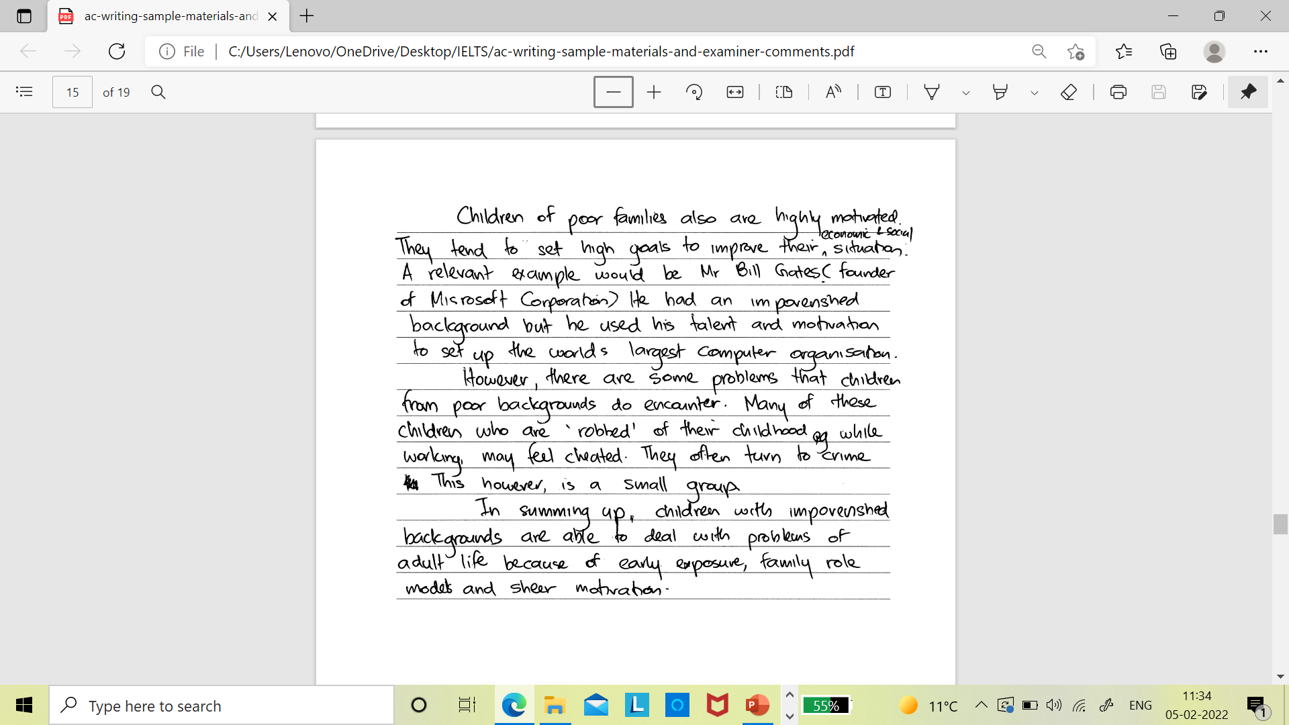
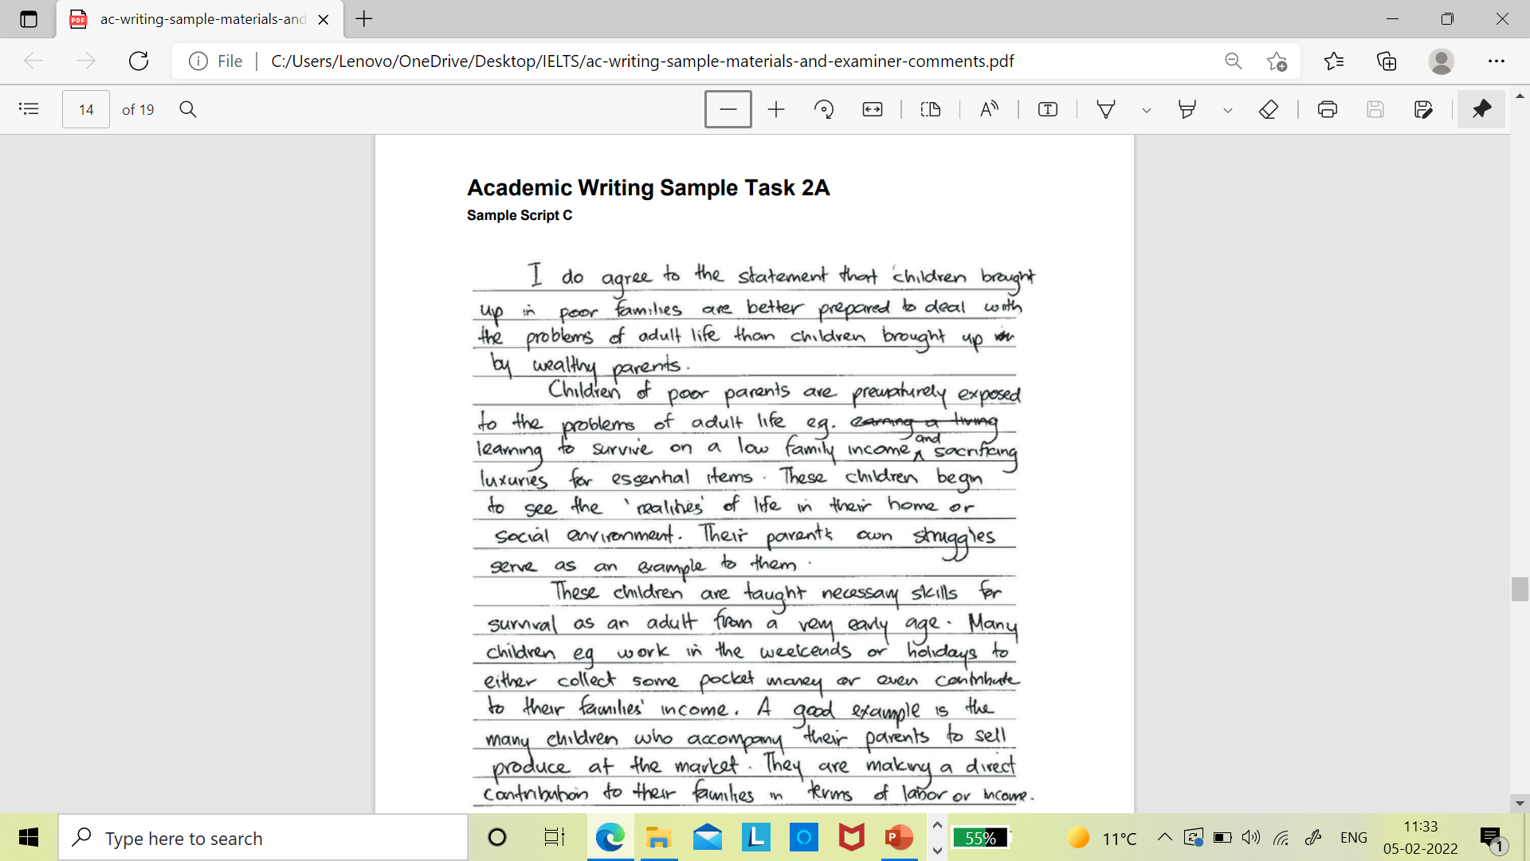
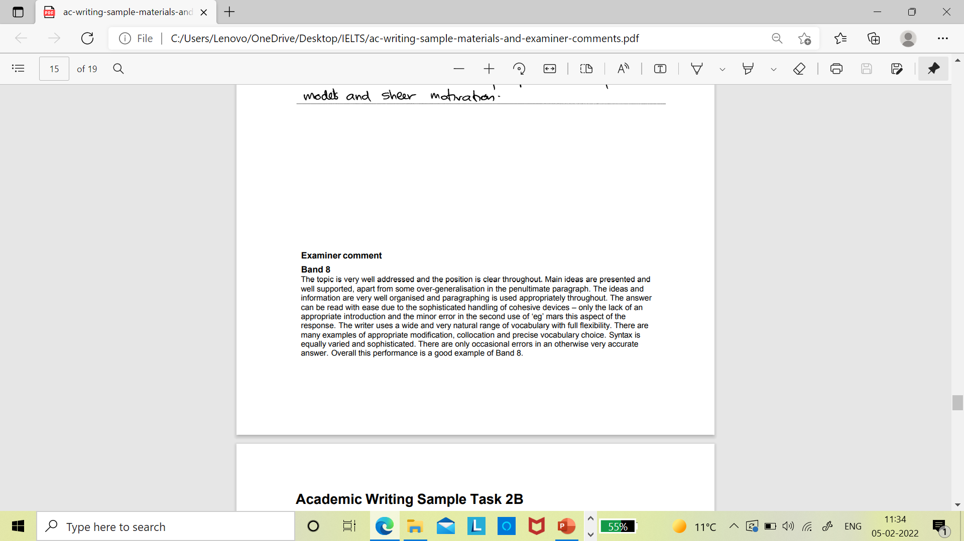

Slide 16
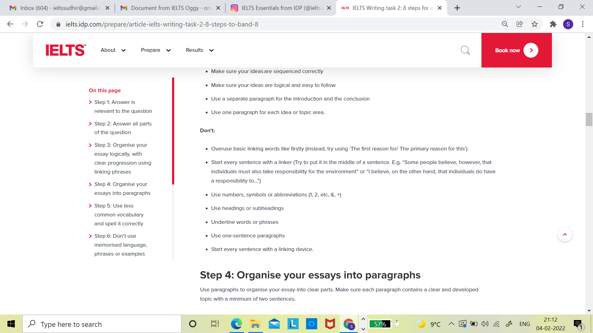

Slide 17
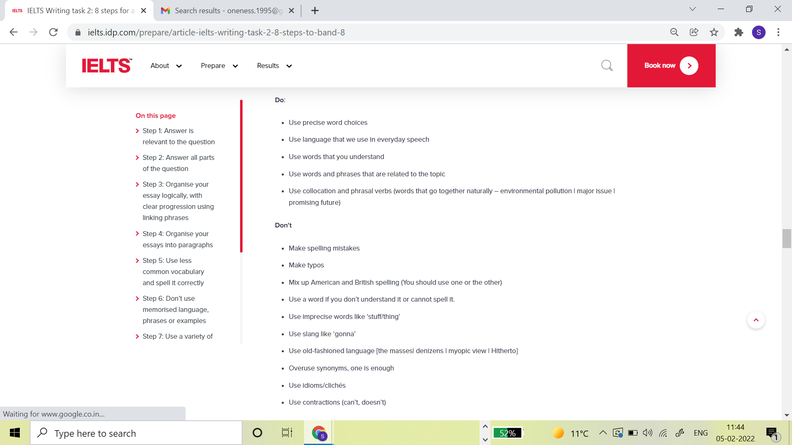

Slide 18
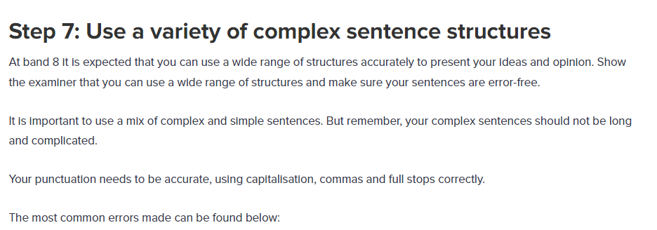

Slide 19
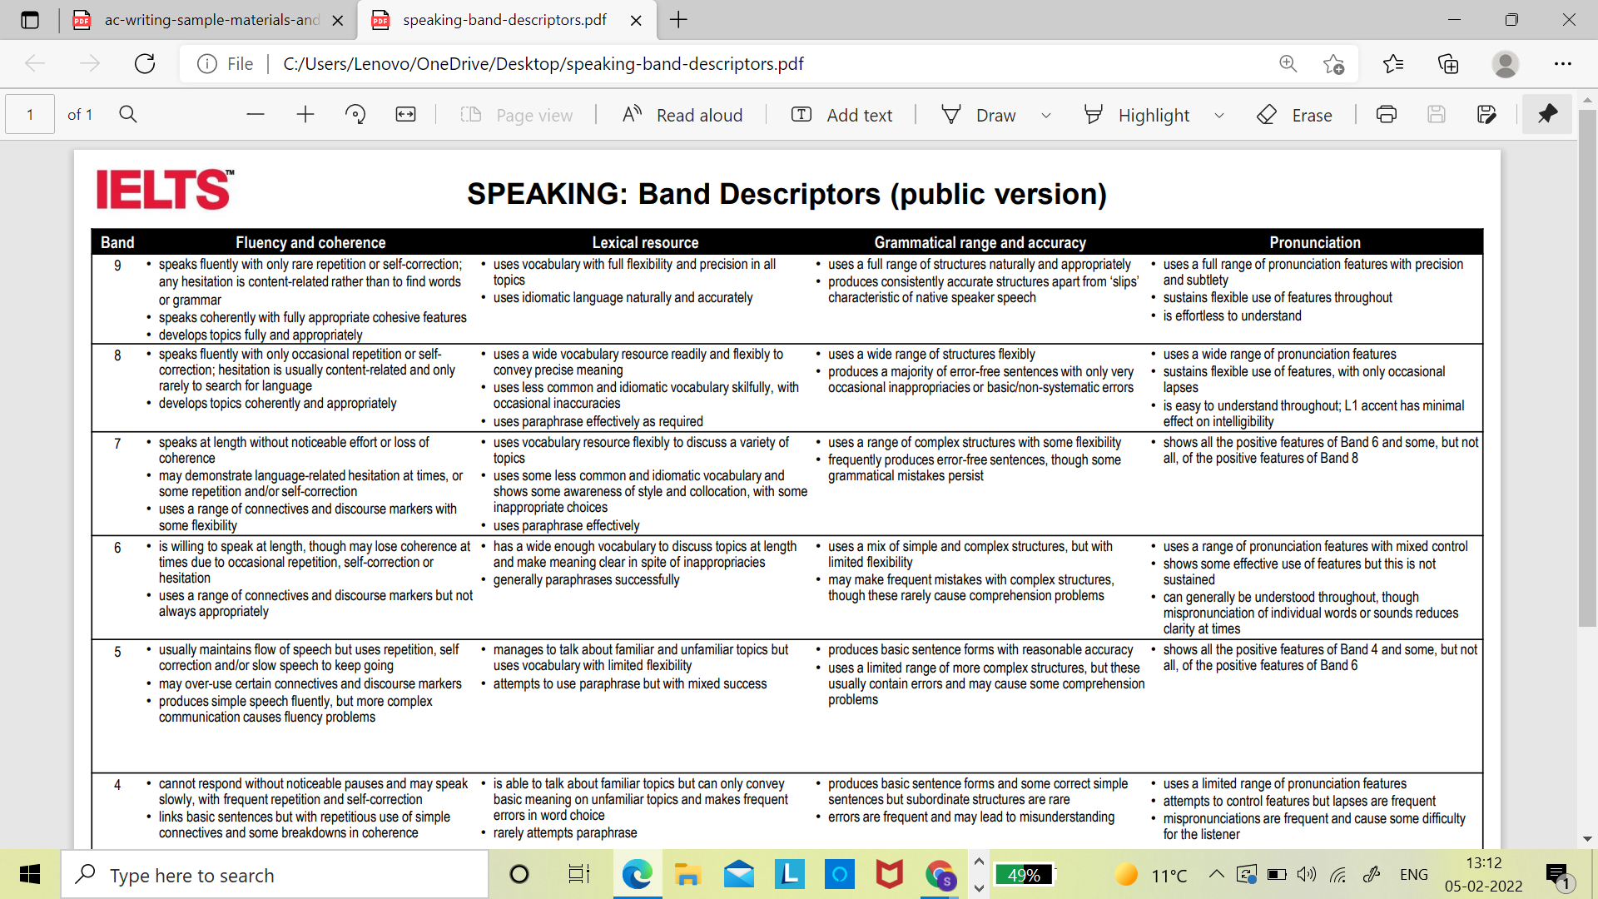
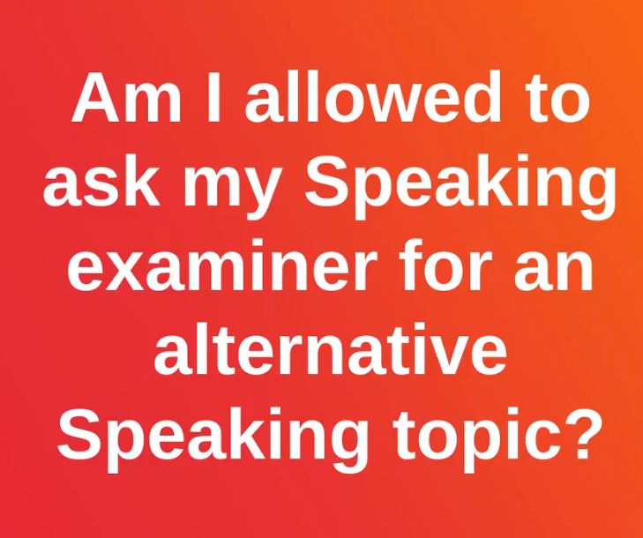
https://www.instagram.com/p/CEmFHqmghPJ/

Slide 22
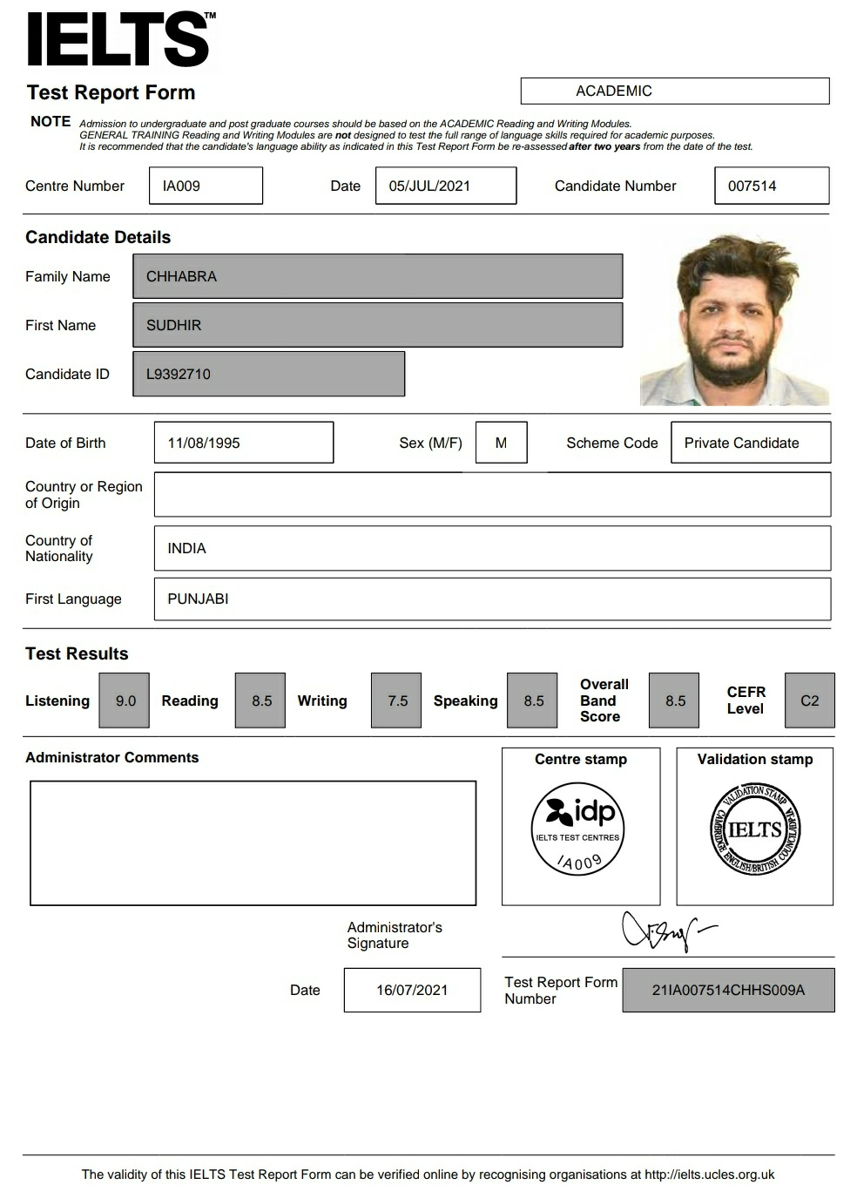
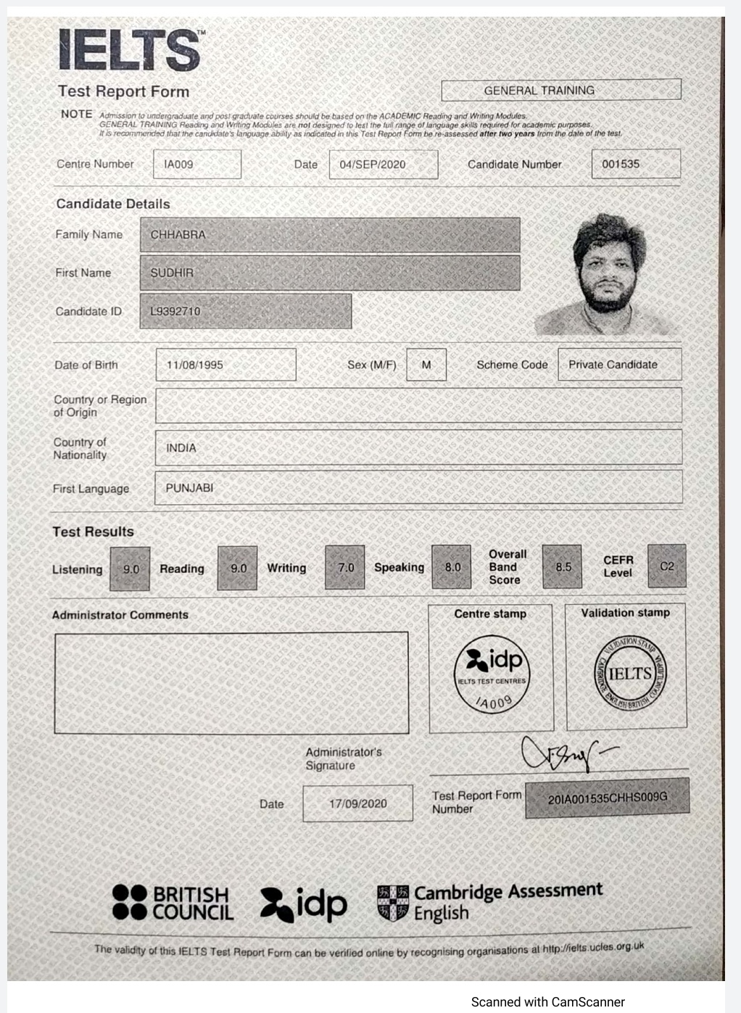
While both IELTS Academic and IELTS GT give you an essay as the second writing task, the themes in the latter are much simpler. Sudhir Chhabra

Slide 23
Day 2
Listening Maps Opinion Essay Speaking Test

Slide 24
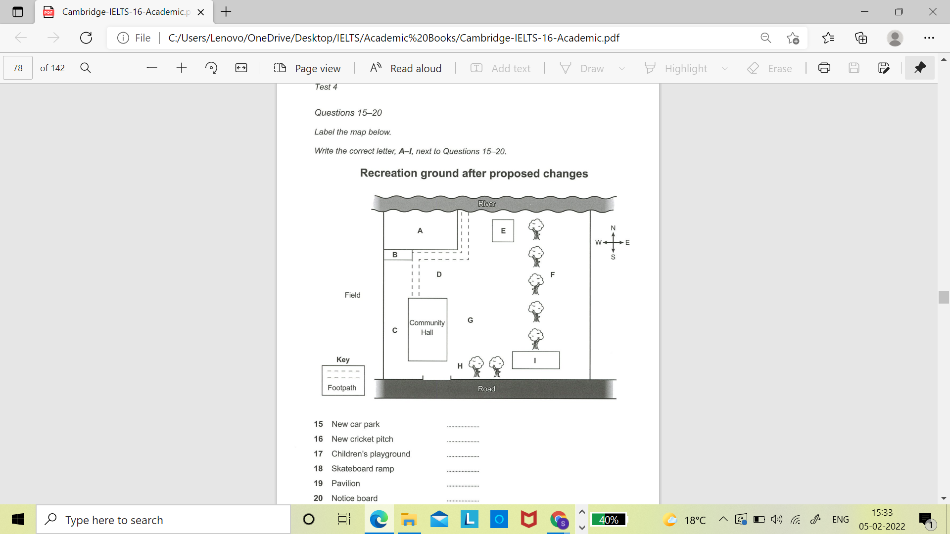
Audio

Slide 25
Opinion Essay
1.
Do you agree or disagree?
2.
3.
To what extent do you agree or disagree?
What is your opinion about this?

Slide 26
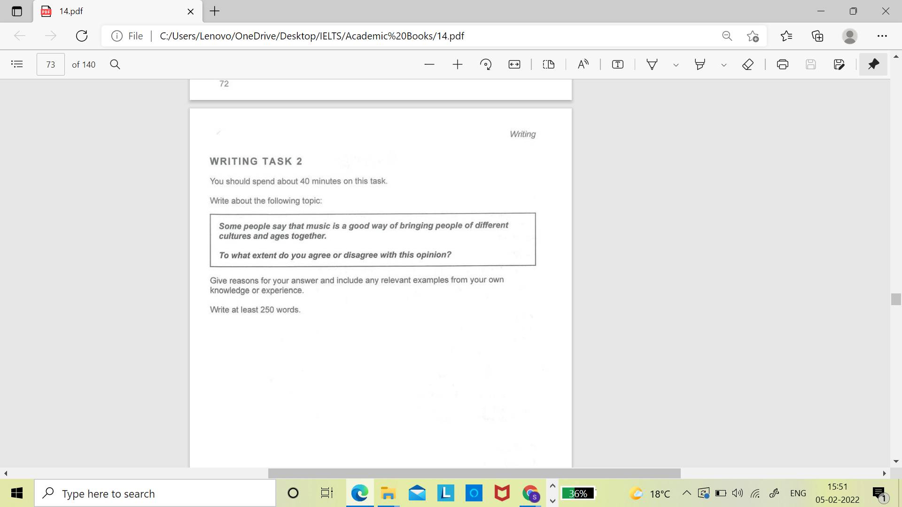

Slide 27
Enjoying music is a natural characteristic of humans. Almost every emotion of ours finds an instant connection with a specific kind of beat. For instance, we relieve ourselves of gloom with sad numbers, and we dance to party songs for cherishing good times. Nonetheless, what musical pieces an individual selects can be in stark contrast with those chosen by another person of a different age group or ethnicity. Hence, thinking that music can effectively lead to cohesion among differently aged or raised humans is wrong.

Slide 28
To begin with, age-related issues come into the way of bonding by music because of different life conditions. That is to say, people of varying ages have different mindsets. For example, the young are in pursuit of making careers and enjoying their youth. Therefore, they are energetic. By contrast, the old are highly spiritual and calm. Now, such mental and bodily configurations extensively affect what musical genres different individuals vouch for. Thus, the youth opt for peppy numbers, and the old, on the other hand, prize mellow music. With such differences in choices of music, getting these two, and in general any two, age groups together using songs and melodies is clearly improbable.

Slide 29
Subsequently, a culture is defined by various elements. One of such major elements is music. Now, there are contrasting cultural variations in the world. As a result, there are variations in the associated forms of music, too. Such variations keep people of distinct cultures from one another in place of with each other. To illustrate, in India, South Indians do not like the Punjab-defining upbeat music. Similarly, the Punjabi community does not take a shine to soul-soothing South Indian rhythms.

Slide 30
In conclusion, music cannot act as a binding force among individuals with age gaps owing to age-based music choices. Further, it cannot do so for different ethnic groups, too, as different cultures are not fond of one another’s music forms.

Slide 31
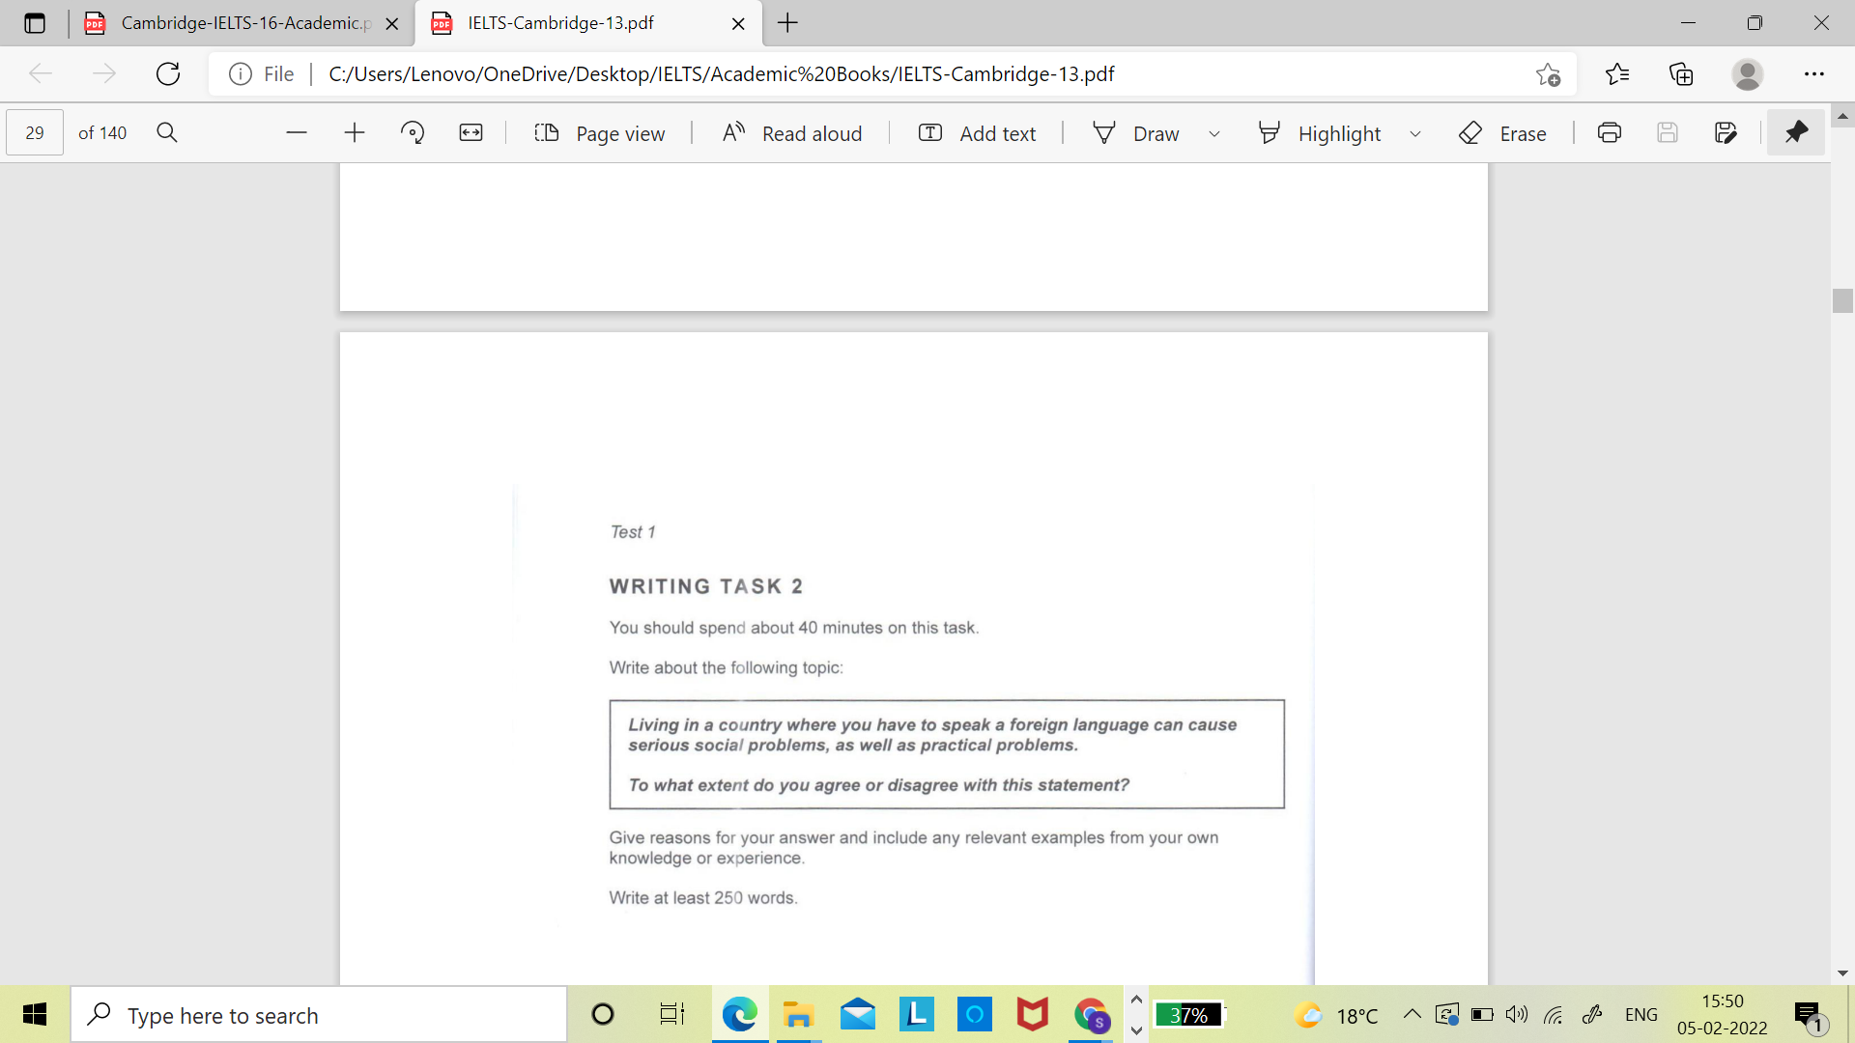
Homework

Slide 32
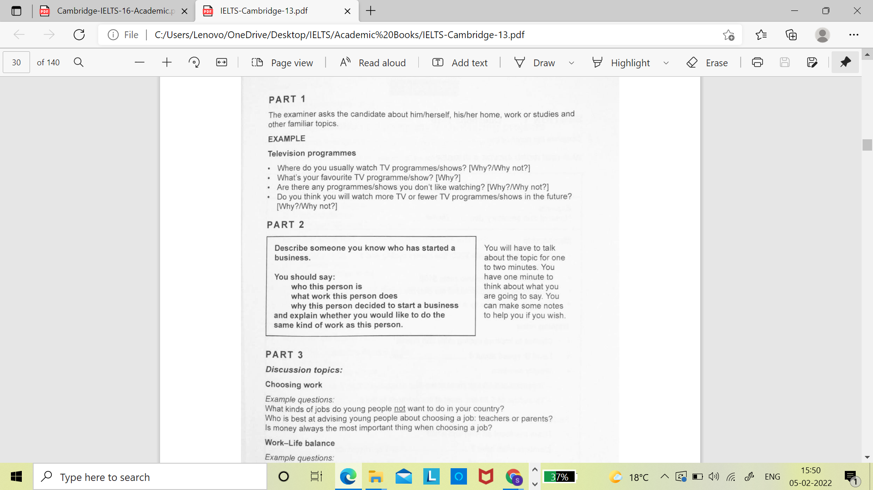

Slide 33
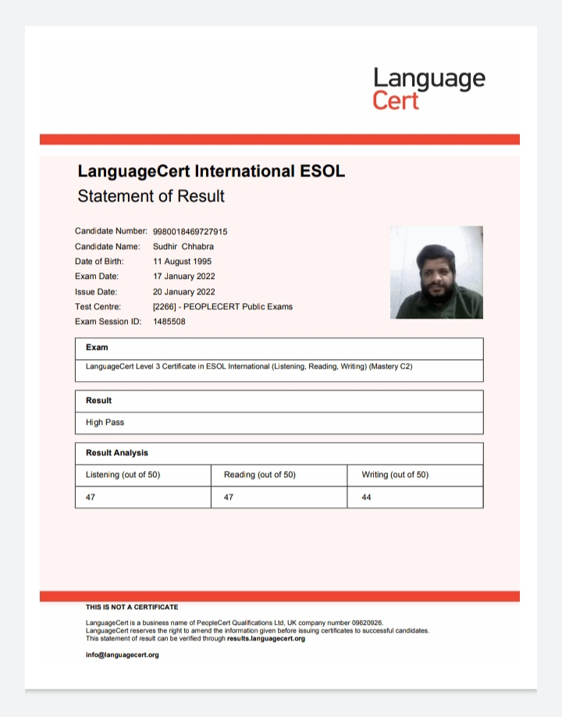
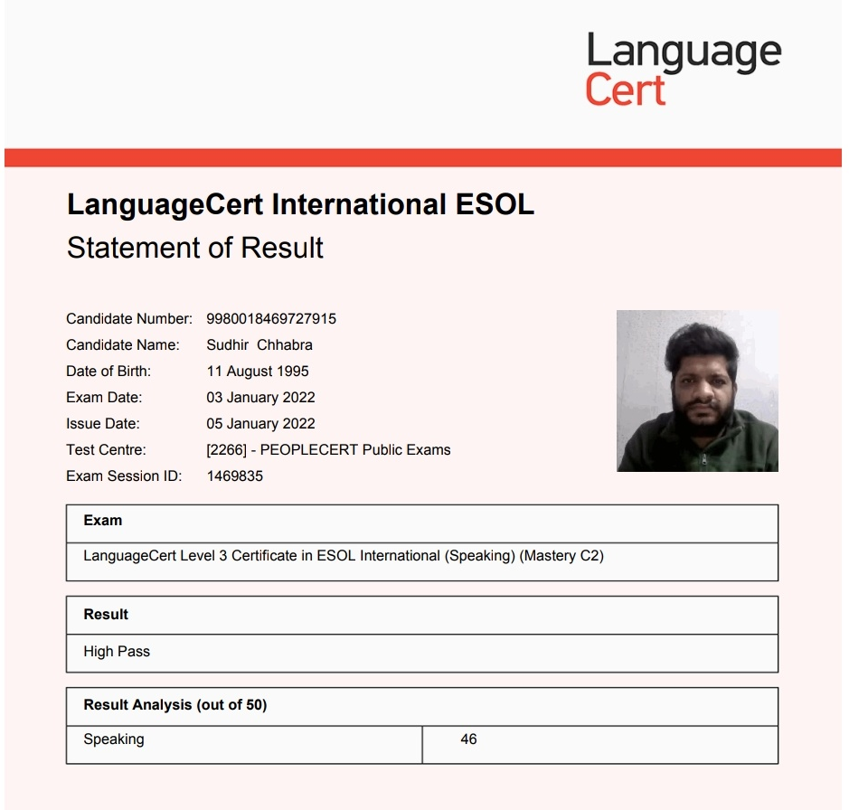
This one was a challenging exam. Especially, the writing part requires you to write a story in one of the two tasks. The other three modules were more or less like the IELTS counterparts. Sudhir Chhabra

Slide 34
Day 3
Reading Which Paragraph Writing Task 1 Introduction Speaking Test

Slide 35
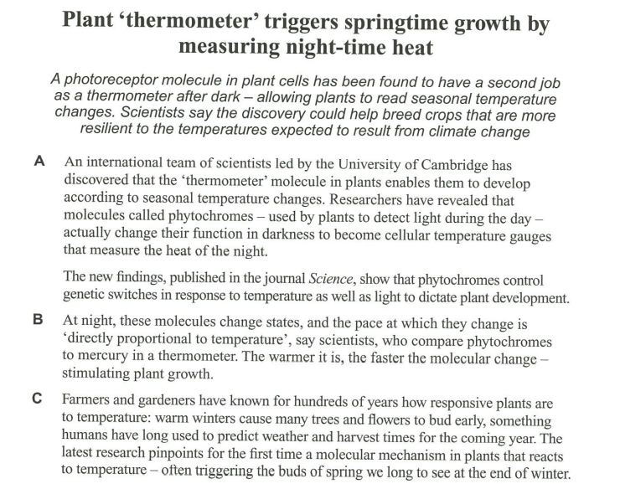
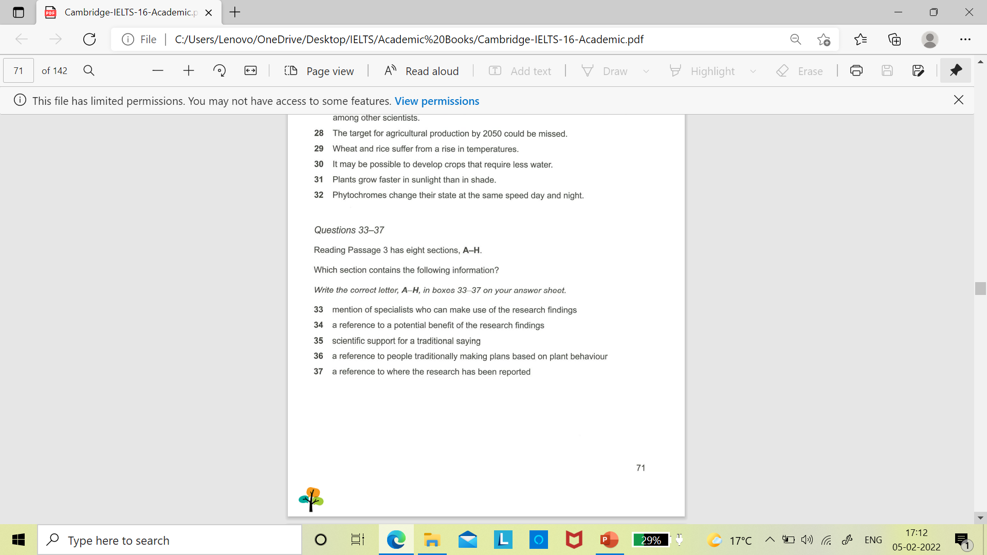
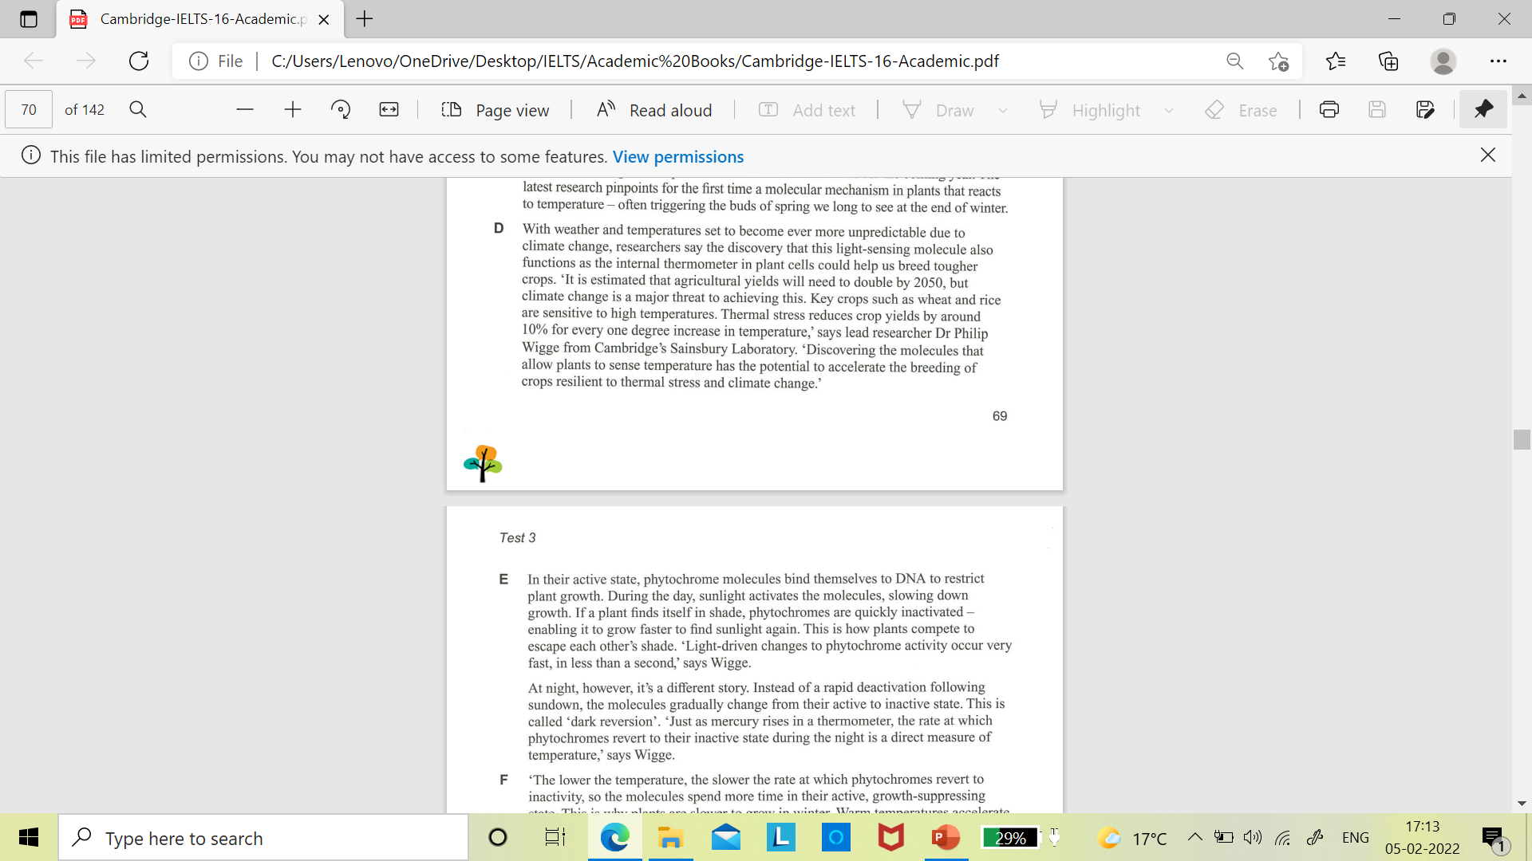

Slide 36
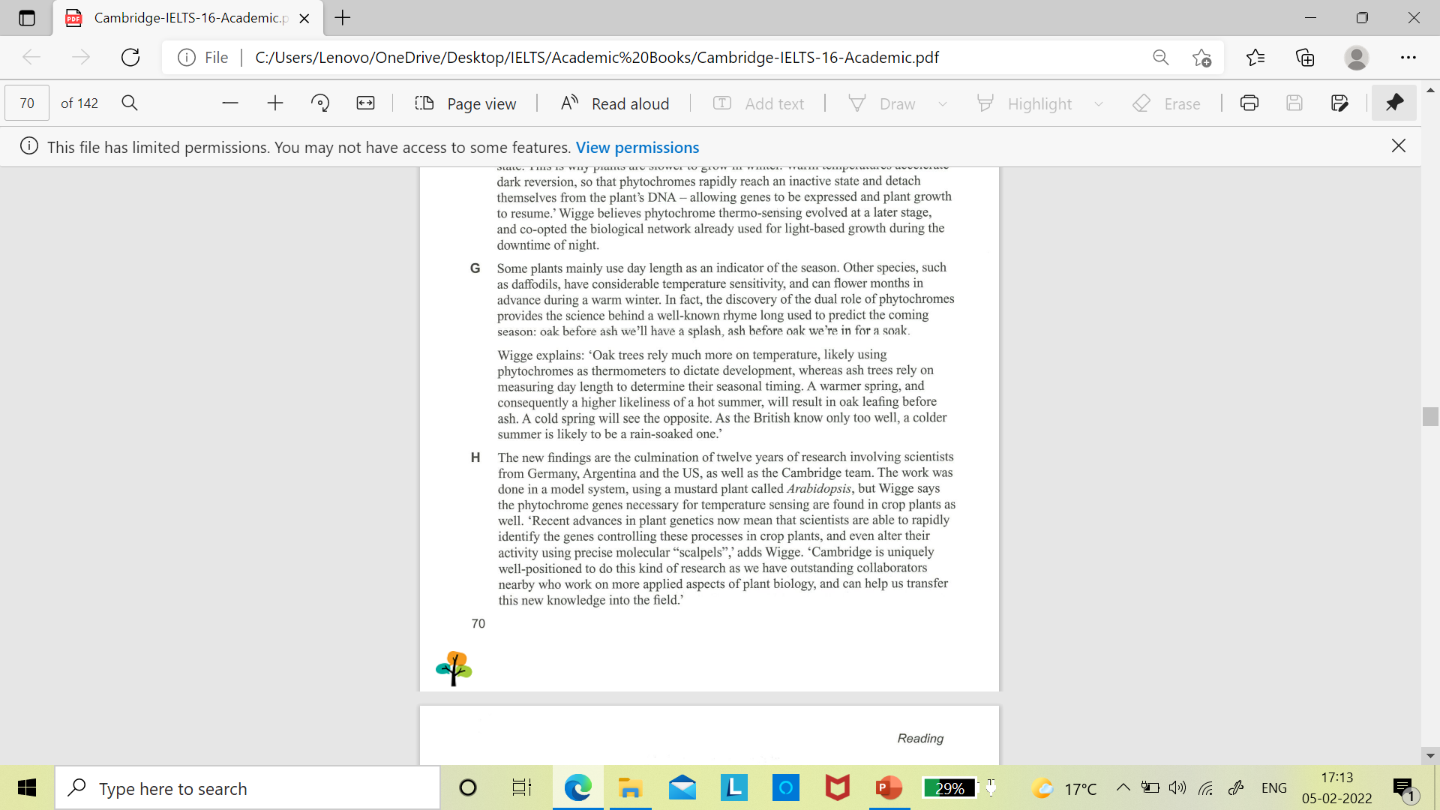
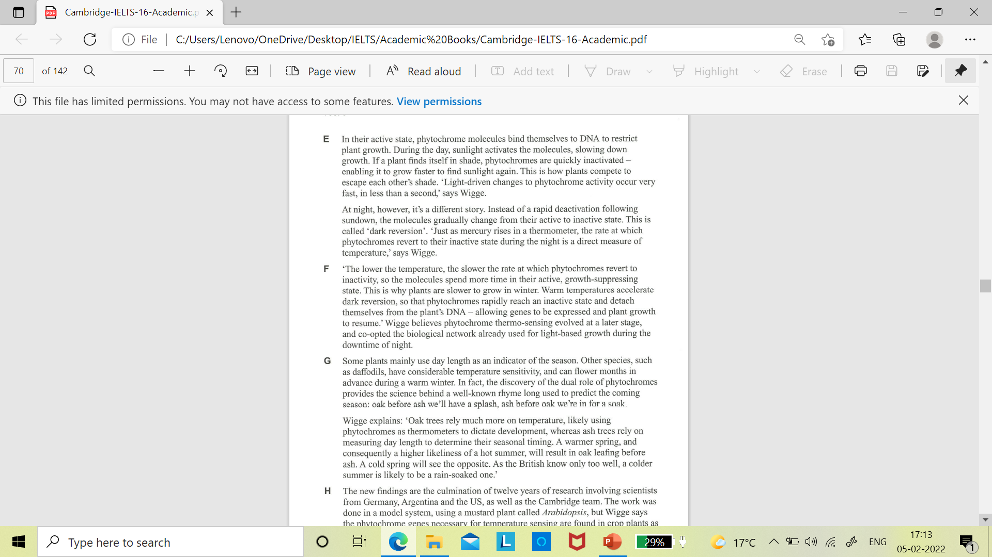

Slide 37
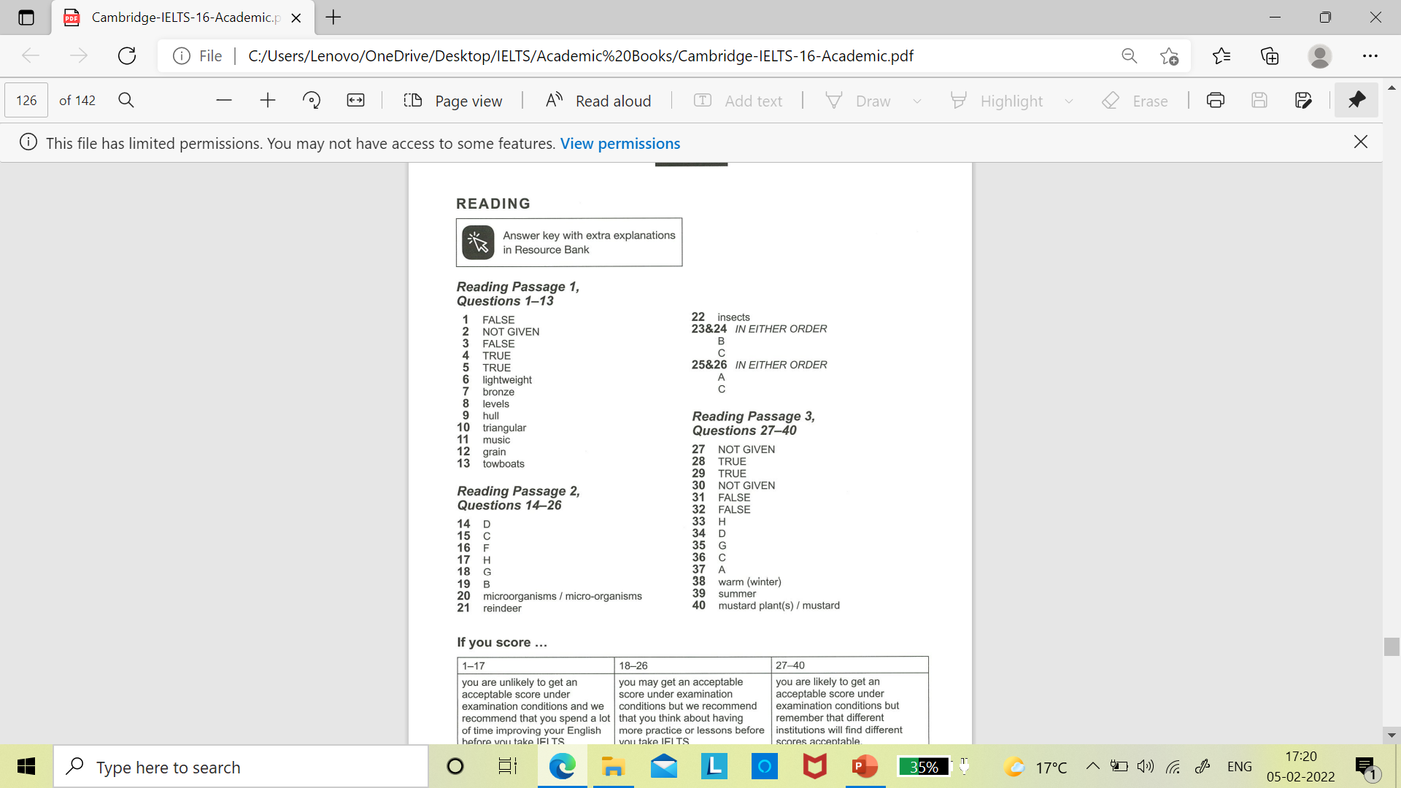

Slide 38
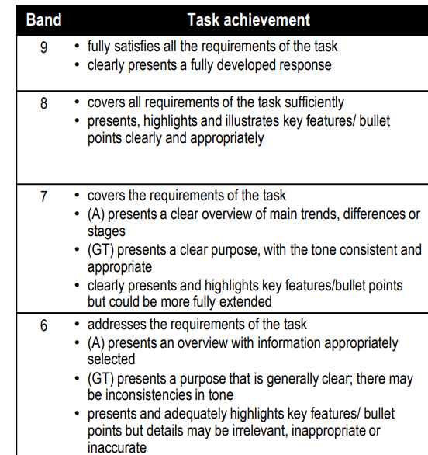

Slide 39
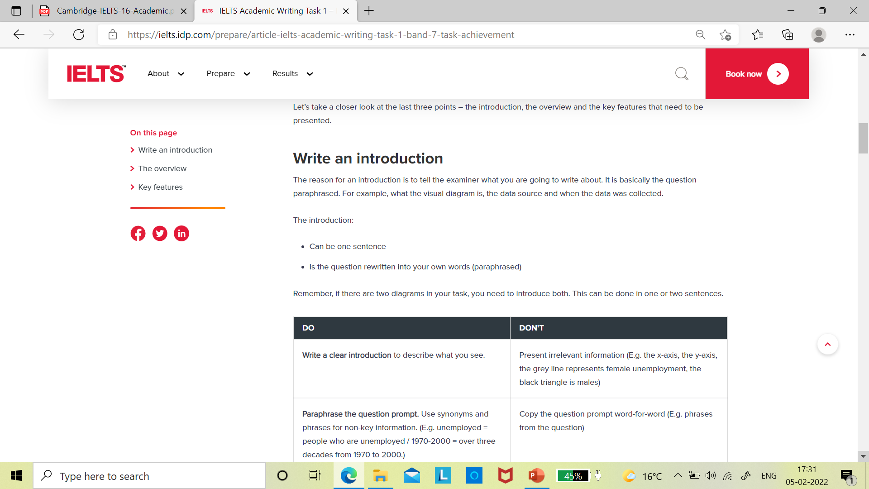

Slide 40
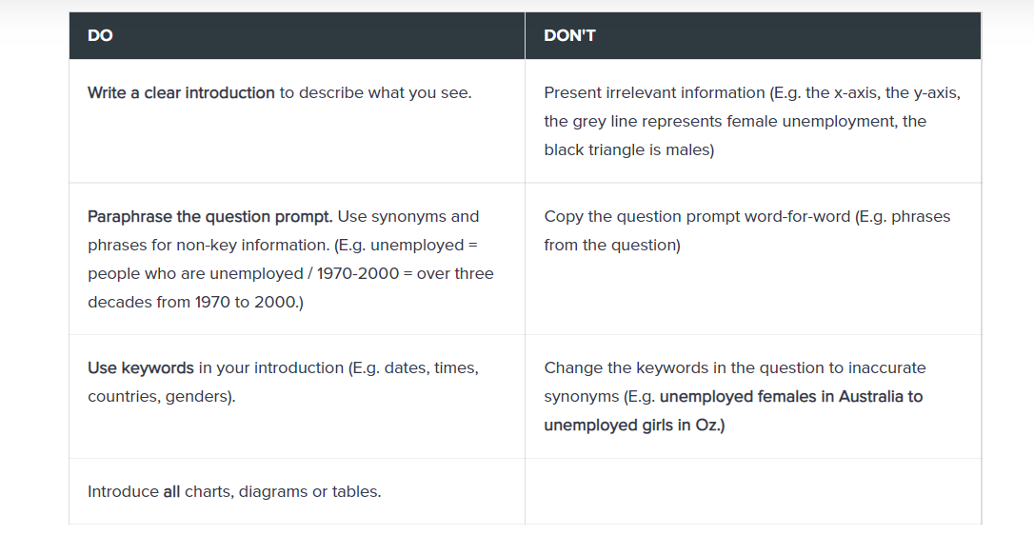

Slide 41
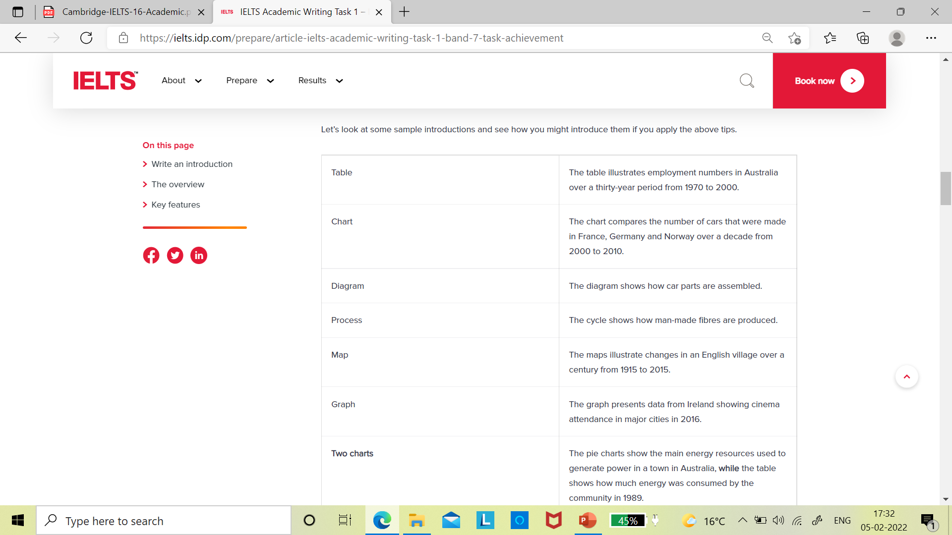

Slide 42
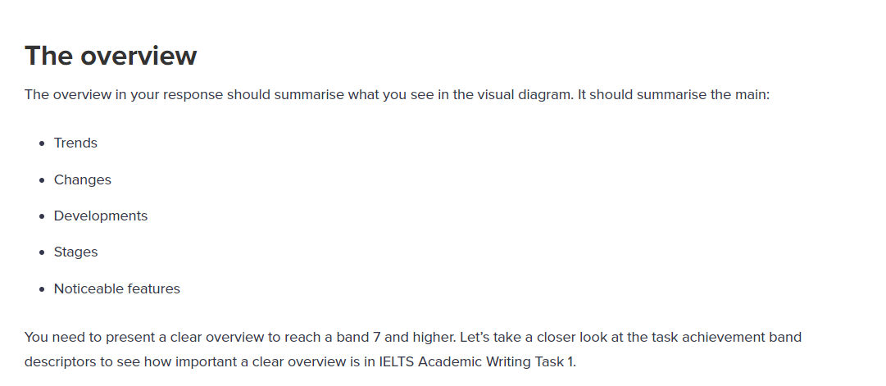

Slide 43
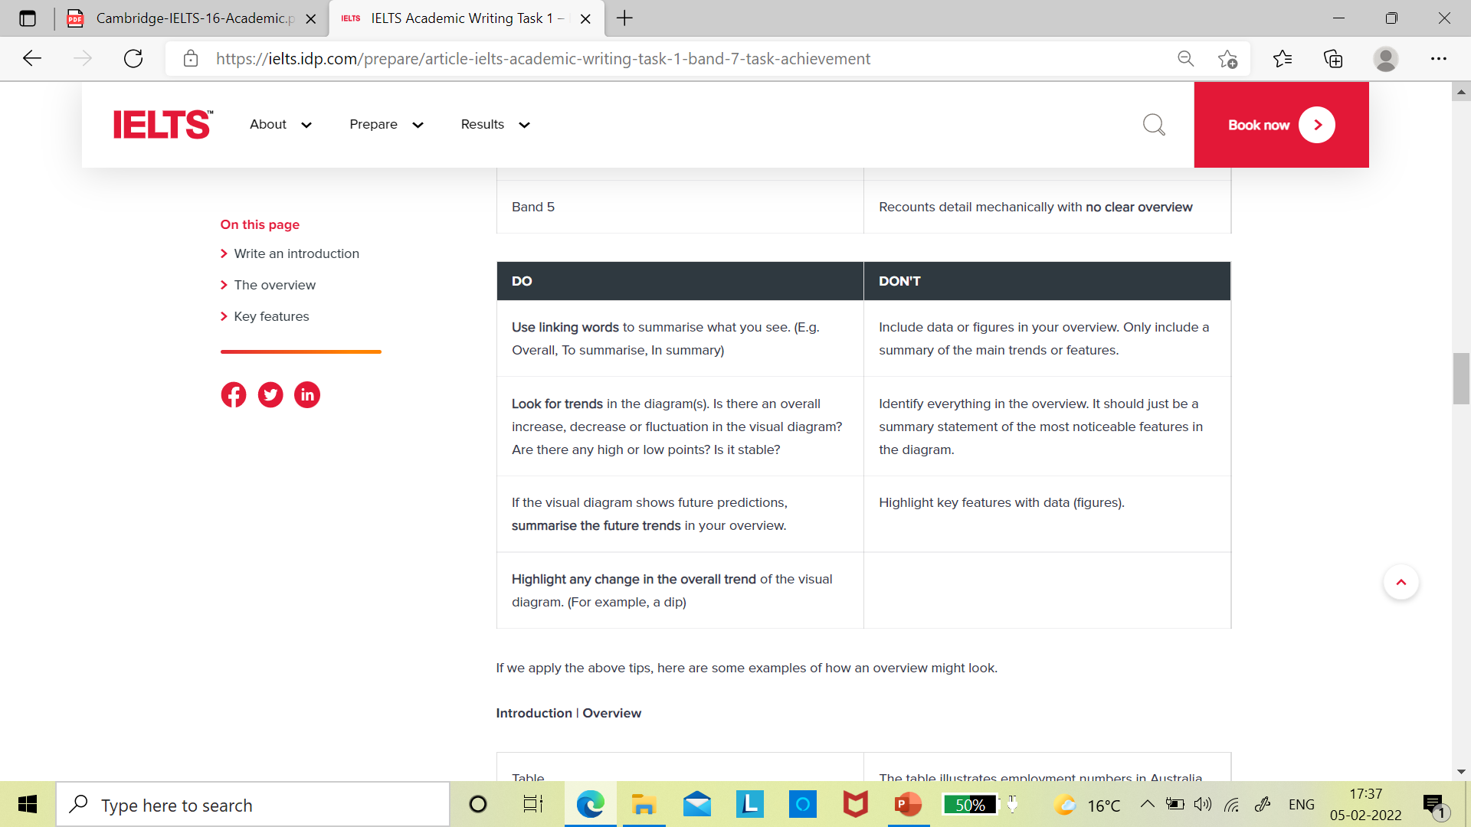

Slide 44
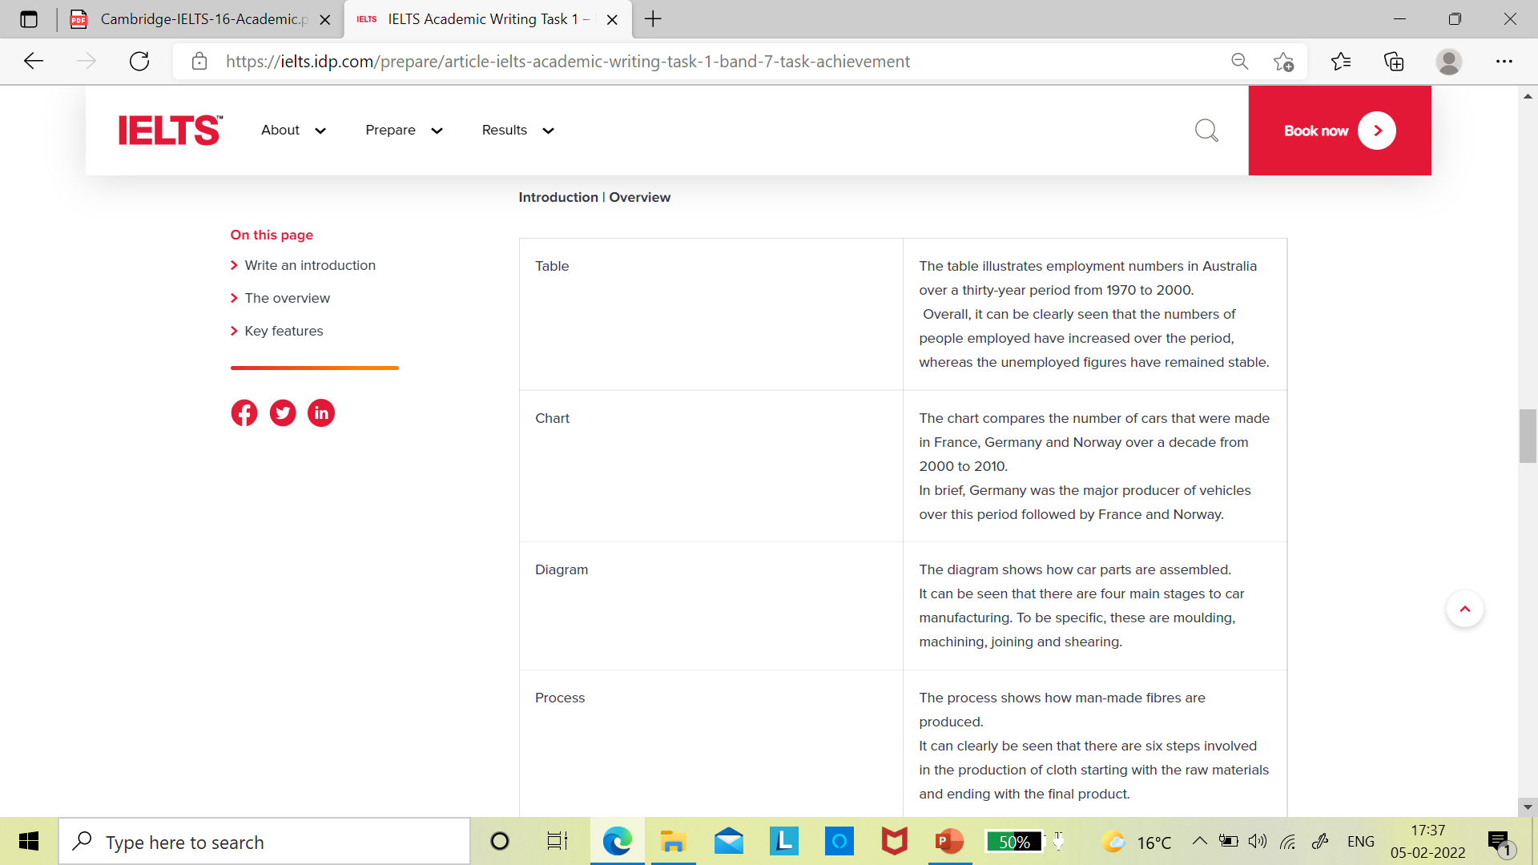

Slide 45
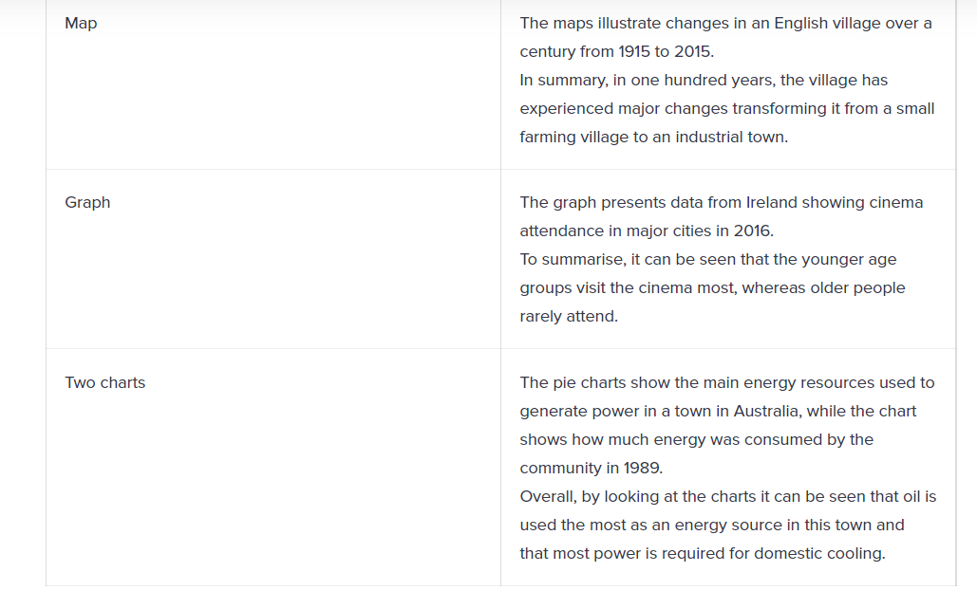

Slide 46
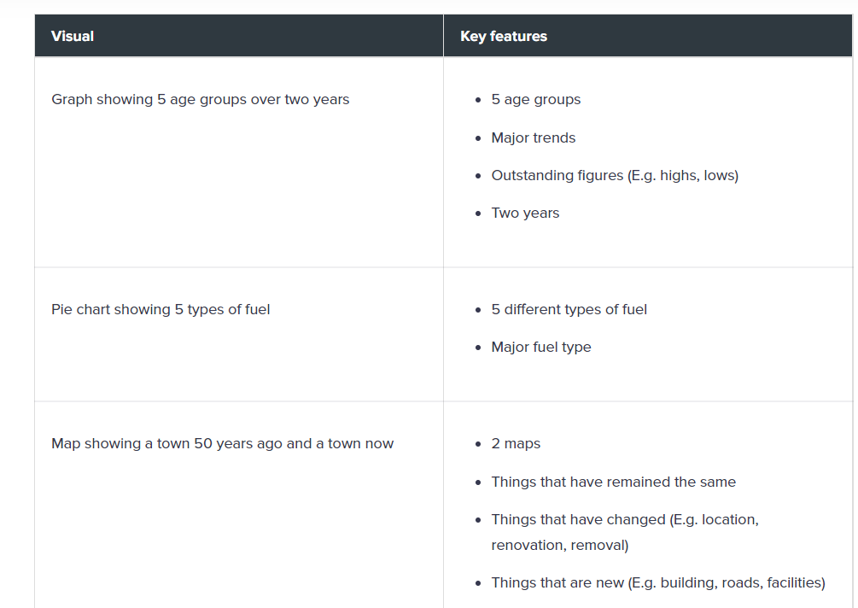

Slide 47
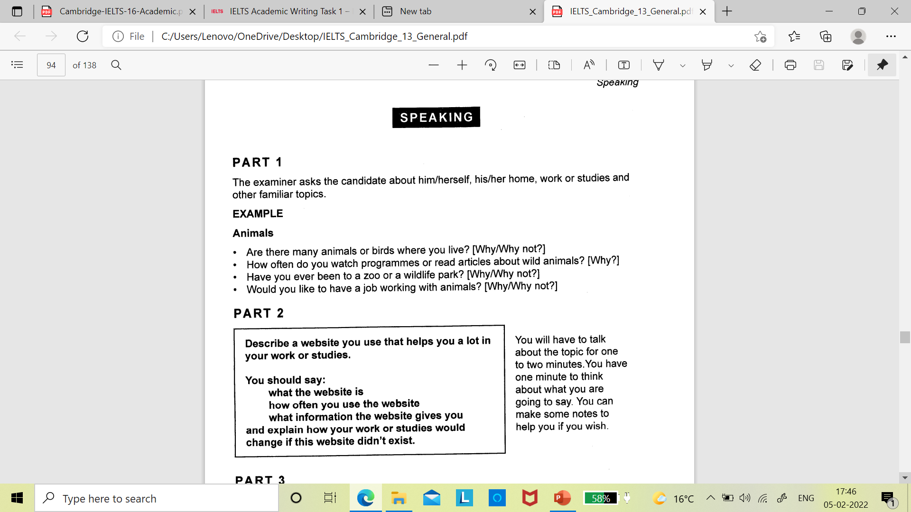

Slide 48
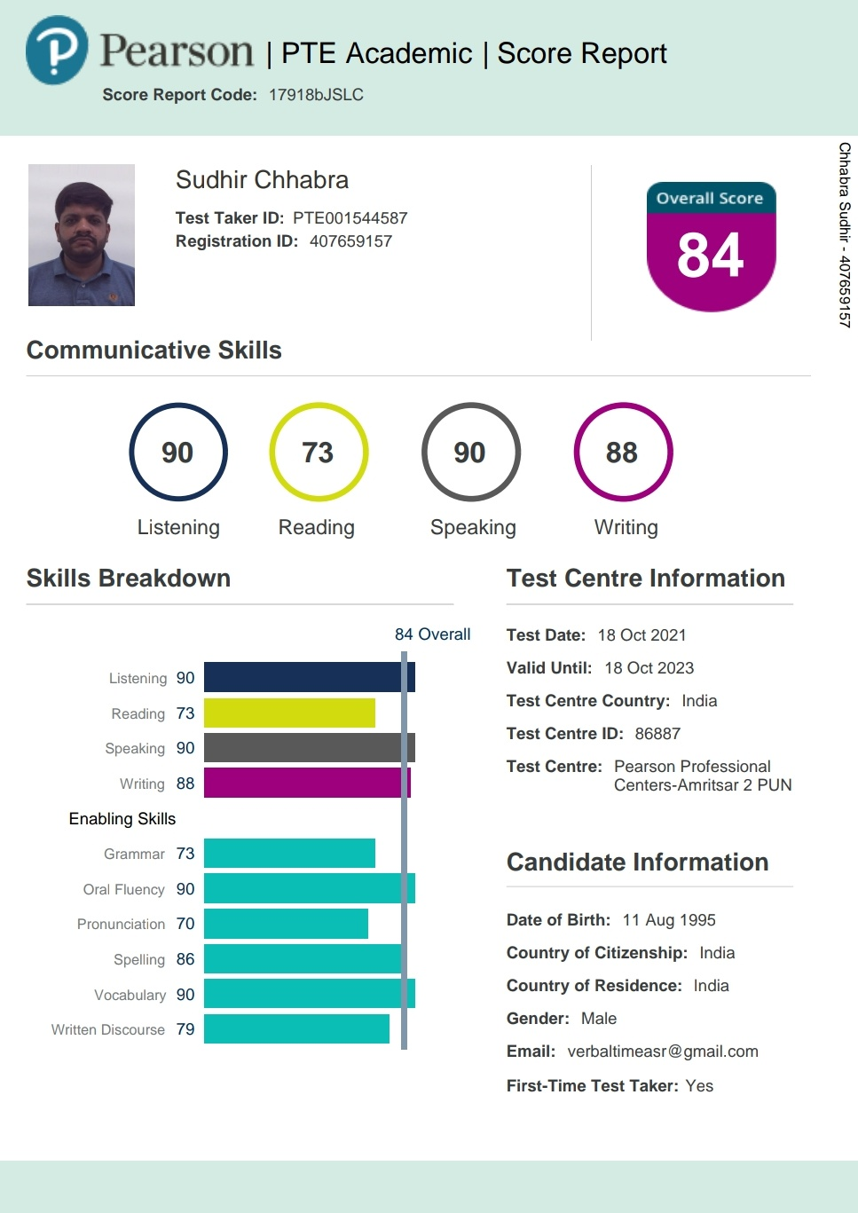
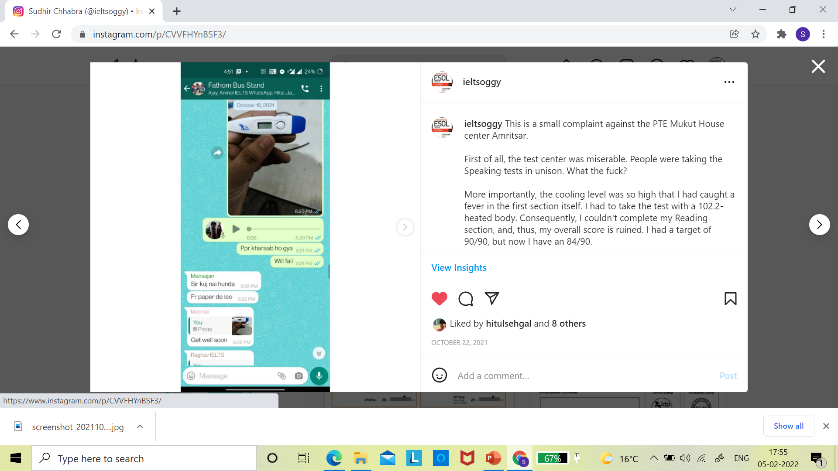
One thing I did not like about the PTE was how it was conducted. It was like a congregation. People were taking the speaking tests sitting next to one another.
Moreover, I had fallen ill while taking the exam (most probably) owing to the cooling level in the room.
Sudhir Chhabra

